Slide 1
Name : Adarsh Pandey
Class : SYBCA-B
Subject : Web Designing
Topic : HTML List Tags

Slide 2
HTML List Tags
List tags are used to represent any information as ordered or unordered list.
HTML provide four types of List as below:
Unordered List
Ordered List
Description/Definition List
Nesting List

Slide 3
1) Unordered List
The List in which List item is not given a Number or Sequence are called Unordered List.
Unordered List represent each list item with some preceding symbols like Square, Disc or Circle.
An unordered list starts with the <ul> tag. Each list item starts with the <li> tag.

Slide 4
<UL>…</UL>
Syntax:
<ul type="disc|circle|square|none" compact>
<li> … </li>
</ul>
Attributes:
Type: type attribute specify symbol for list items values can be disc, circle or square. Default value is disc.
Compact: it makes list compact by reducting space between list items . It is removed from HTML 5.

Slide 5

UL example
<ul>
<li>Coffee</li>
<li>Tea</li>
<li>Milk</li>
</ul>
Output:

Slide 6
2) Ordered List
The List in which List item is given a Numbers or Sequence are called Ordered List.
Ordered List represent each list item with some preceding Numbers which may be numeric or alphabetic.
An Ordered list starts with the <ol> tag. Each list item starts with the <li> tag.

Slide 7
<OL>…</OL>
Syntax:
<ol type=“1/ A/ a/ i/ I" compact start=“Number” Reversed>
<li> … </li>
</ol>
Attributes:
Compact: It makes list compact by reducting space between list items. It is removed from HTML 5.
Start: Specifies the starting value of an ordered list.
Reversed: Specifies that the list order should be descending (9,8,7...)

Slide 8
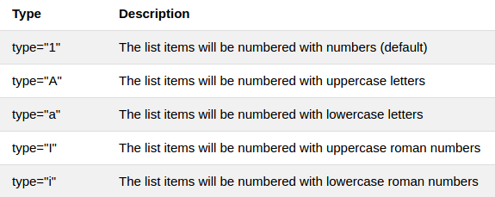
<OL>…</OL>
Type: type attribute sequence type for list items values can be as follows:

Slide 9

OL example
<ol>
<li>Coffee</li>
<li>Tea</li>
<li>Milk</li>
</ol>
Output:

Slide 10
List Item <li>
The <li> tag defines a list item.
The <li> tag is used in ordered lists <ol>, unordered lists <ul>.
Syntax:
<li type="1 | A | a | i | I | disc | circle | square none" value="Number" >
</li>
Type: Specifies which kind of bullet point will be used.
Value: Specifies the value of a list item. The following list items will increment from that number (only for <ol> lists).

Slide 11
3) Description List<dl>
The <dl> tag defines a description list.
It was called Definition List in HTML 4.
The <dl> tag is used in conjunction with <dt> (defines terms/names) and <dd> (describes each term/name).

Slide 12
<dl>…</dl>
Syntax:
<dl>
<dt>...</dt>
<dd>…</dd>
</dl>

Slide 13

DL Example
<dl>
<dt>Coffee</dt>
<dd>Black hot drink</dd>
<dt>Milk</dt>
<dd>White cold drink</dd>
</dl>
Output:

Slide 14
4) Nested List
A list item can contain another entire list, this is known as ‘Nesting ‘ a list.
It is useful for tables in which one topic is within another topic such as syllabus.
The nested <ul> can be the child of the parent</ul> and can contain another <ul>…</ul> or <ol>…</ol>.

Slide 15
Nested List
Syntax:
<body>
<ul>
<li>...
<ol>
<li>...</li>
</ol>
</li>
</ul>
</body>

Slide 16
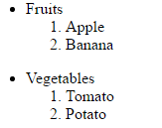
Nested List Example
<body>
<ul>
<li>Fruits
<ol>
<li>Apple</li>
<li>Banana</li>
</ol>
</li>
</ul>
<ul>
<li>Vegetables
<ol>
<li>Tomato</li>
<li>Potato</li>
</ol>
</li>
</ul>
</body>
Output:

Slide 17
THANK YOU

